Slide 1
PROJECT PROPOSAL PRESENTATION
EduMart
An Online Learning Material Store — E-Commerce Platform for Digital & Physical Study Resources
Group Size: 5 Members
Platform Type: Web-Based E-Commerce Platform
Stack: React.js • Node.js / Express • MySQL
12 July 2026 • Project Proposal Viva

Slide 2
INTRODUCTION
Overview & Problem Statement
What is EduMart?
EduMart is a web-based e-commerce platform that lets students, tutors, and institutes buy, sell, and access learning materials in one place — past papers, e-books, model papers, revision notes, and recorded lecture packs, across school, A/L and university levels.
3
Material Types
E-books, notes, past papers & video packs
2
User Roles
Students (buyers) & Tutors (sellers)
Problem Statement
Study materials are scattered across Facebook groups, WhatsApp, and photocopy shops — hard to find and unverified.
No single trusted marketplace for both digital (PDF/video) and printed materials with secure payment.
Independent tutors have no easy channel to publish and sell their own content online.
1
Unified Platform
Browse, purchase, download & review
“One trusted marketplace for every learning resource.”
EDUMART | ONLINE LEARNING MATERIAL STORE
02

Slide 3
PROPOSED PLATFORM
Platform Type & Target Users
Web Application
1
Students (A/L & University)
2
School / Tuition Students
Responsive React.js web platform, accessible on desktop, tablet and mobile browsers — no separate app install required.
Search, preview, purchase and download notes, past papers and e-books for exam preparation.
Buy affordable model papers and revision material recommended by their tutors.
Why Web First?
3
Tutors & Content Creators
4
Institutes / Bookshops
Faster to build & test across 5 modules
Register as sellers, upload original material, and track sales through their dashboard.
List bulk study packs and printed material with delivery tracking.
Easy PDF/video preview in-browser
One codebase for all devices
EDUMART | ONLINE LEARNING MATERIAL STORE
03

Slide 4
OBJECTIVES
Main Objectives & Expected Outcomes
01
02
03
Centralized Marketplace
Multi-Format Support
Seller Empowerment
Build one platform where verified learning material can be listed, discovered and purchased securely.
Support digital downloads (PDF/video) and printed material with delivery tracking, in a single cart.
Give tutors an easy way to publish content, manage listings and view sales analytics.
04
05
06
Trust & Quality
Smart Discovery
Reliable Transactions
Use ratings, reviews and an admin approval flow to keep material quality high.
Help students find the right resource quickly with search, filters and recommendations.
Provide secure payments, order history and instant notifications for every purchase.
EDUMART | ONLINE LEARNING MATERIAL STORE
04

Slide 5
PROPOSED FEATURES
Core Functionalities
User Authentication (Student / Tutor / Admin roles)
Product (Study Material) Catalog with categories & subjects
Search & Filtering by subject, grade, exam year, price
Shopping Cart & Multi-item Checkout
Secure Payment Gateway Integration
Order Management & Purchase History
Digital Delivery — instant download links for e-materials
Physical Delivery Tracking for printed material
Review & Rating System for each material
Notification System — email/SMS order & upload alerts
Admin Dashboard — approve listings, manage users & orders
Seller (Tutor) Dashboard — uploads, sales & earnings
AI Chatbot — 24/7 instant help, FAQs & order status queries
Coupon & Discount Management for promotions
EDUMART | ONLINE LEARNING MATERIAL STORE
05

Slide 6
ADDITIONAL FEATURES
Innovative Features That Set Us Apart
01
02
03
AI-Based Recommendations
Free Preview Pages
Wishlist & Save for Later
Suggests related past papers, notes & courses based on browsing and purchase history.
Watermarked sample pages / video trailer before purchase to build buyer confidence.
Students can bookmark material to buy closer to exam time.
04
05
06
Bundle Deals
Tutor Verification Badge
Progress Tracker & Certificates
Auto-generated subject bundles (e.g. "Full A/L Chemistry Pack") at a discount.
Admin-verified tutors get a trust badge, boosting buyer confidence.
Tracks completed materials per subject and issues a completion certificate.
06

Slide 7
TECHNOLOGY STACK
Frontend, Backend, Database & Tools
Frontend
Backend
Database
APIs / Services / Tools
React.js (SPA)
Node.js + Express.js
MySQL (Relational DB)
Stripe / PayHere Payment Gateway
React Router DOM
REST API architecture
Sequelize ORM
Cloudinary / AWS S3 (file storage)
Redux Toolkit / Context API
JWT Authentication
Structured schema for orders & catalog
Nodemailer (email alerts)
Tailwind CSS
Multer (file uploads)
Git & GitHub, Postman, Figma
EDUMART | ONLINE LEARNING MATERIAL STORE
07

Slide 8
DATABASE PLAN
Database Type, Entities & Relationships
Relationships & Data Flow
Relational Database
A User (role = Tutor) can list many Materials → one-to-many
A User (role = Student) places many Orders → one-to-many
An Order contains many OrderItems, each linked to one Material → many-to-many via OrderItems
A Payment record links to exactly one Order → one-to-one
A Review links one User to one Material, after a completed Order → many-to-many via Reviews
Notifications reference a User and an Order/Material event → one-to-many
MySQL
Chosen for strong relational integrity between users, orders, payments and catalog items — ideal for a transactional e-commerce system.
Main Entities
• Users
• Materials
• Categories
• Cart / CartItems
• Orders / OrderItems
• Payments
• Reviews
EDUMART | ONLINE LEARNING MATERIAL STORE
08
• Notifications

Slide 9
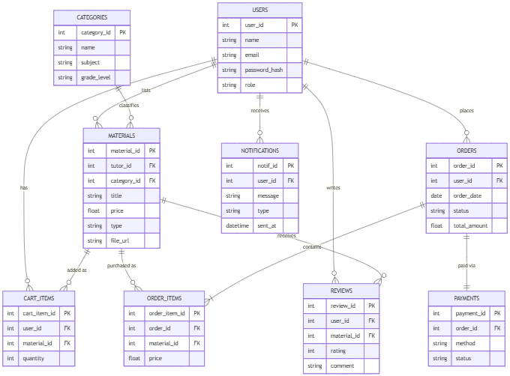
Entity Relationship Diagram (ERD)
USERS
ORDERS
PK = Primary Key • FK = Foreign Key • Lines indicate relationships between entities
EDUMART | ONLINE LEARNING MATERIAL STORE
09

Slide 10
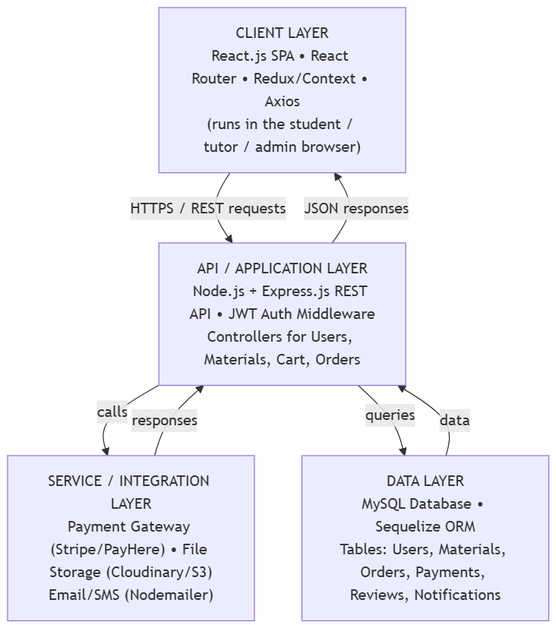
System Architecture
CLIENT LAYER
API / APPLICATION LAYER
DATA LAYER
Request flows top-down (Client → API → Services → Database); responses flow back up as JSON.
EDUMART | ONLINE LEARNING MATERIAL STORE
10

Slide 11
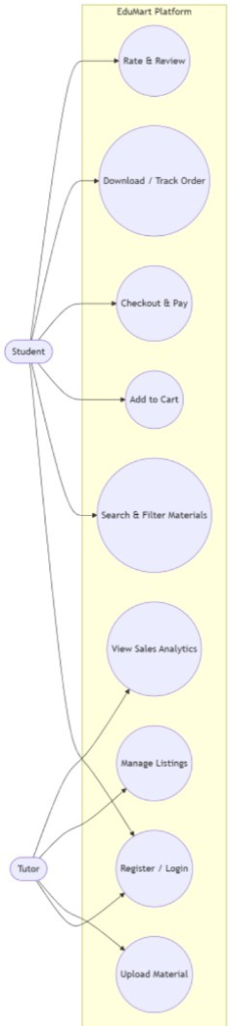
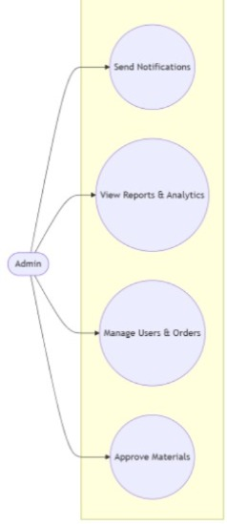
Use Case Diagram
EDUMART | ONLINE LEARNING MATERIAL STORE
11

Slide 12
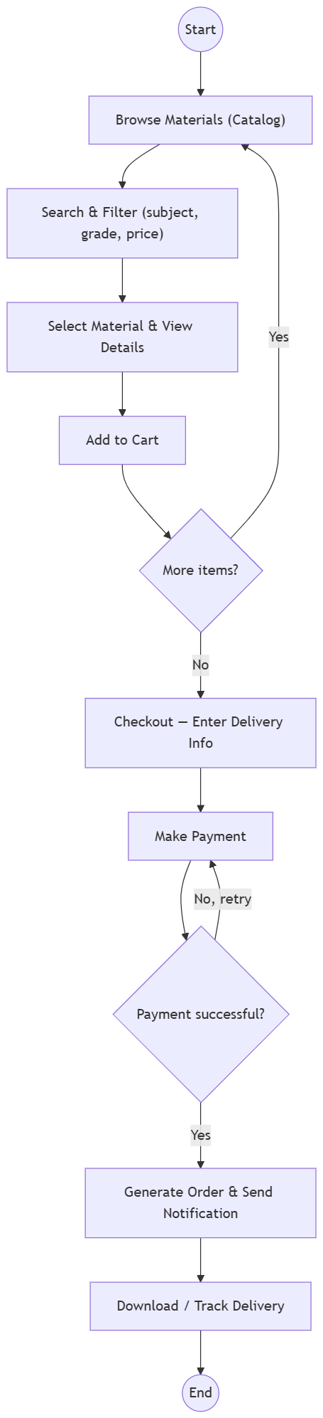
Activity Diagram — Purchase Flow
EDUMART | ONLINE LEARNING MATERIAL STORE
12

Slide 13
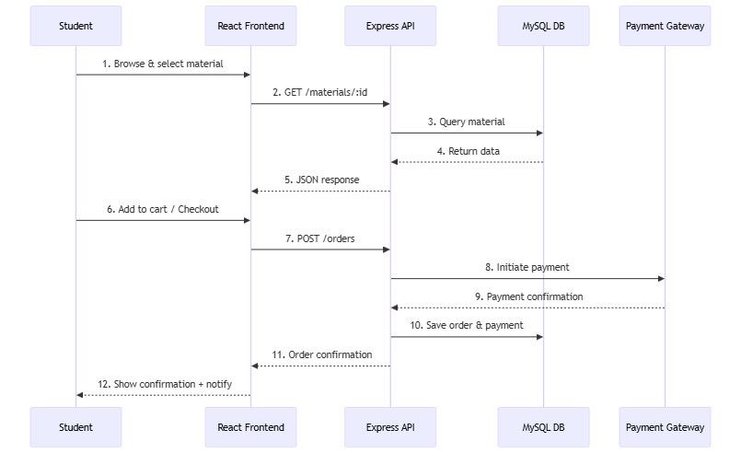
Sequence Diagram — Checkout & Payment
Student
Express API
EDUMART | ONLINE LEARNING MATERIAL STORE
13

Slide 14
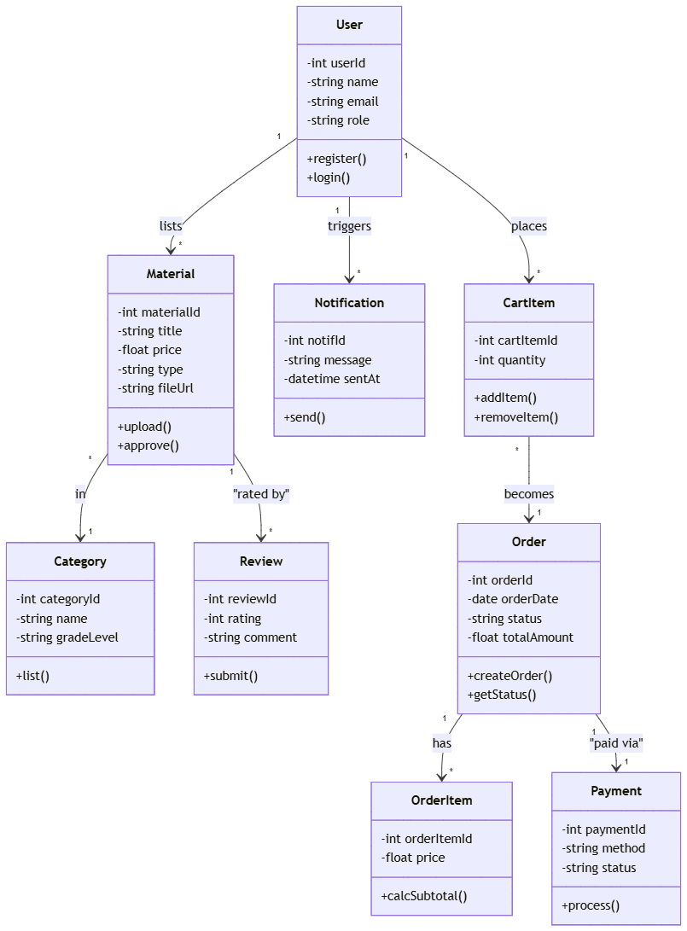
Class Diagram
User
Material
Category
Review
Notification
CartItem
Order
OrderItem
Payment
EDUMART | ONLINE LEARNING MATERIAL STORE
14

Slide 15
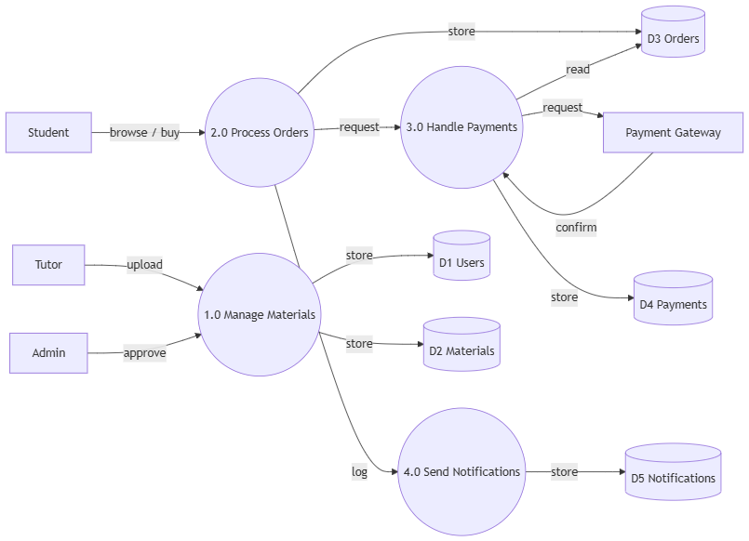
Data Flow Diagram (DFD — Level 1)
External Entities = boxes • Processes = ellipses (numbered) • Data Stores = open rectangles (D1-D5)
EDUMART | ONLINE LEARNING MATERIAL STORE
15

Slide 16
TEAM
Team Member Responsibilities (5 Members)
Kushmi Kaushini
User Authentication & Profile Management
Registration/login, JWT auth, role-based access (Student/Tutor/Admin), profile editing.
Vidula Dhanasekara
Catalog, Search & Filtering System
Material listing pages, categories/subjects, search and filter by grade, subject, price.
Bhanuka Heshan
Shopping Cart & Checkout
Cart management, checkout flow, order summary, delivery details for physical items.
Charuka Mayura
Payment Gateway & Order Management
Payment integration, order status tracking, invoices, purchase history.
Malki Madushi
Admin Dashboard, Reviews & Notifications
Admin panel for approvals/reports, review & rating system, email/SMS notifications.
Note: Assign actual member names before the presentation — module ownership above matches each individual contribution requirement.
EDUMART | ONLINE LEARNING MATERIAL STORE
16

Slide 17
TIMELINE
Tentative Development Schedule
Planning & Design
Core Modules II
Integration & Testing
Requirements, ERD, wireframes, tech setup, GitHub repo
Cart, checkout, payment integration, order management
Merge modules, end-to-end testing, bug fixing
Core Modules I
Admin & Extras
Deployment & Demo
Auth, catalog, search/filter — individual module development begins
Admin dashboard, reviews, notifications, recommendations
Final deployment, documentation, presentation prep
EDUMART | ONLINE LEARNING MATERIAL STORE
17

Slide 18
Thank You
EduMart — bringing every learning resource, and every student, onto one trusted platform.
Group Size: 5 • React.js + Node.js/Express + MySQL
18

